Slide 1


Intro to
Programming
With python
Fundamentals:
Variables + Operators
Wednesday, February 12 2025 TOH210
Notes:
Layout objects pulled from: https://slidesgo.com/
All icons are from: https://thenounproject.com/

Slide 2
Takeaways from last time
Things you should know:
what an algorithm is, how to think algorithmically
pseudocode
computers talk in binary
we use Python

Slide 3

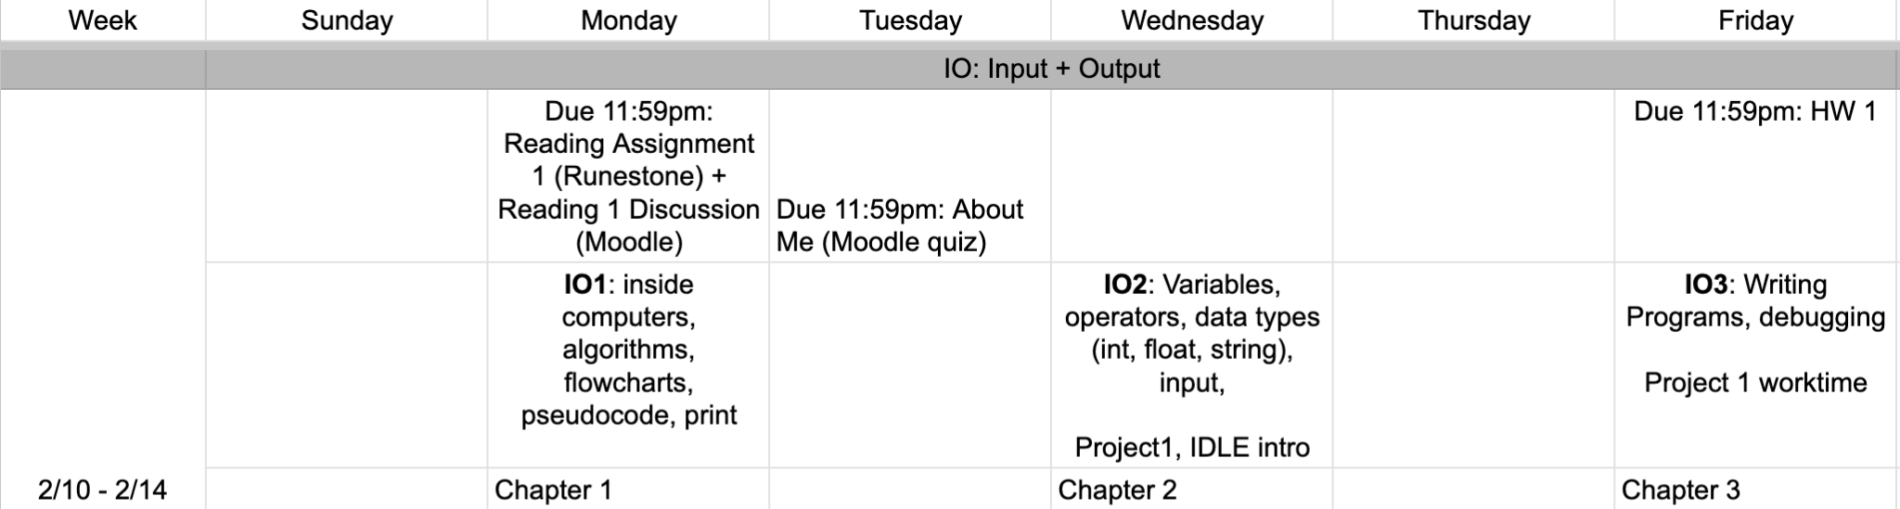
upcoming schedule
google sheet link
Consider starting on this as soon as possible
Ask questions during office hours today

Slide 4
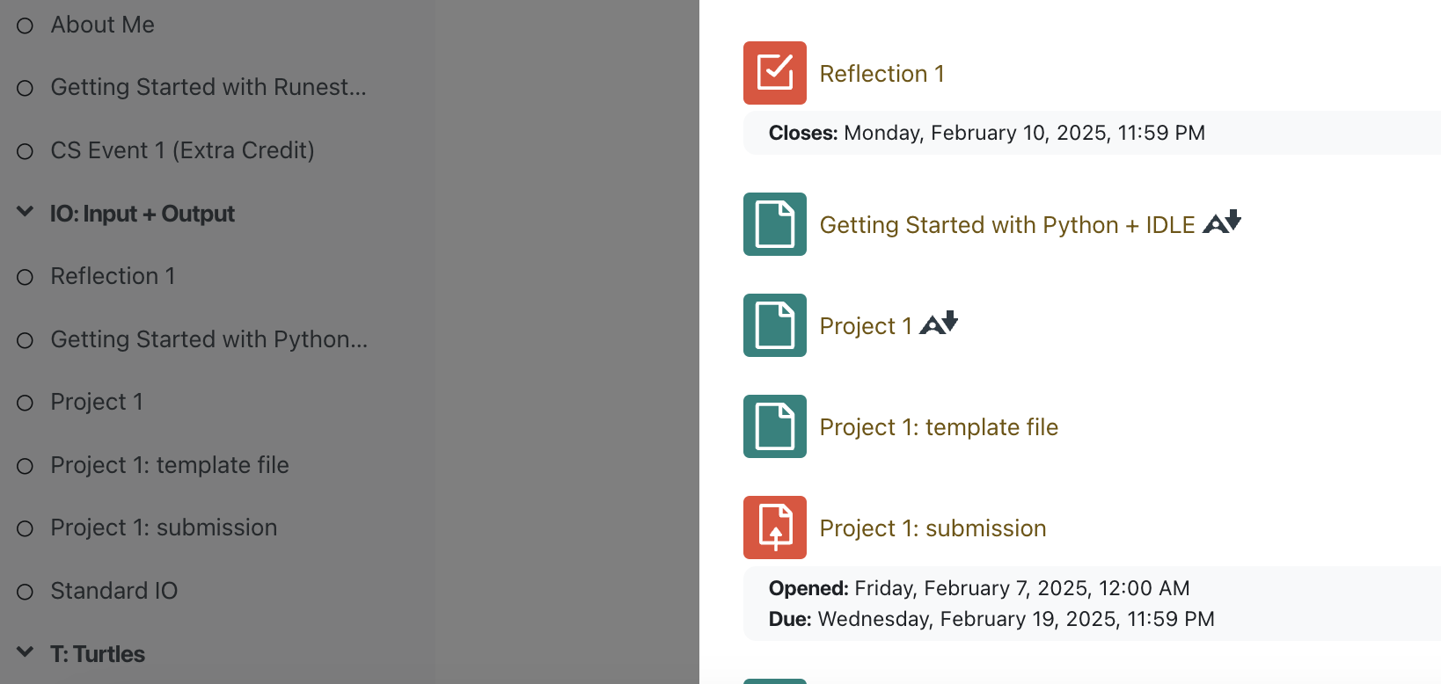
Project 1 and IDLE+Python guide both up on Moodle!

Slide 5
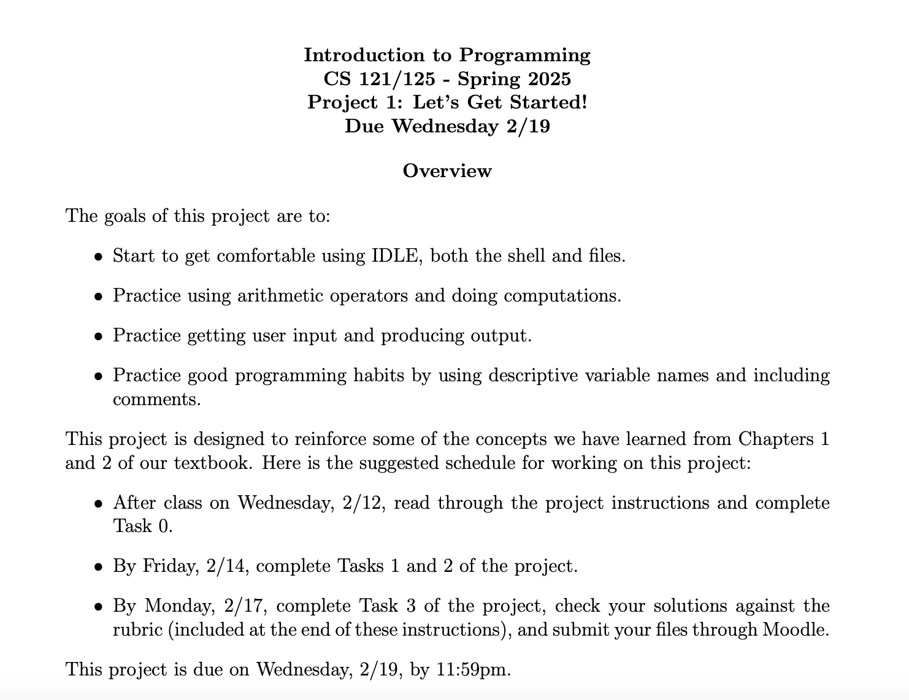

Slide 6
‘string’ * 2
expression vs literal
are videos required?
an expression does operations on literals
Nope! Just an alternative format for information
code block reassignment was a bit tricky
order of operations, what?
We’ll see more examples of this during class today
As you see more examples, this will make more sense. It’ll come up on HW2, so go to OH or TA if you want an in-depth explanation

Slide 7
Colab workbook
Link: click for access

Slide 8


discussion
workbook
Apple bagging
Diana is writing a program to help an apple orchard. She knows that the orchard gathered in total 42 apples this week, and then sold them in bags of five. She adds some calculations to her program that she thinks would be helpful.
42 / 5 = 8.4 42 // 5 42 % 5
= 8
= 2
Context: There are exactly 8.4 bags of apples in total
Context: There are 8 full bags of apples
Context: There are 2 apples that are unbagged
What is Diana calculating when she uses the // and % operators, and what is the context of that expression in terms of apples or bags of apples?

Slide 9
Arithmetic Operators
**
when computing using operators, the order (precedence) matters (similar to PEMDAS in math)
exponent
( ) → ** → * / // % → + -
2 ** 3 = 8
*
/
//
%
floor division (quotient)
modulus (remainder)
multiplication
division
7 * 4 = 28
7 / 4 = 1.75
7 // 4 = 1
5 % 3 = 2
3
start
-
+
0
helpful to visualize modulus as a clock
2
1
1
subtraction
addition
4
5
2
7 - 4 = 3
7 + 4 = 11

Slide 10
does not round up!
you can change from one to another in a process called casting using int() and float() functions which take another data type as input
/
//
floor division (quotient)
follow along in workbook to see this in action
division
7 / 4 = 1.75
7 // 4 = 1
float(5) = 5.0
int(3.14) = 3
int(3.9) = 3
int(7/4) = 1
float(7//4)= 1.0
returns a decimal returns an integer
floats
ints
int() also does not round up!
Another way of thinking about this is that it is unaware of anything happening to the right of a decimal point
in Python, numbers are stored as ints (integers, whole numbers) and floats (decimals, floating point numbers) and these types are managed automatically
1.75
1
why both? variety of ways numbers are used:
floats are good for calculations
ints are good for counting and iteration

Slide 11
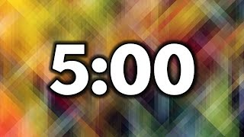
Discussion
workbook
Predict the output
(1+2)**3
4 + 3 / 8
int((4+3)/2)
float(19//5)
3*(1//3)
1/3
1.2 - 1
= (3)**3 = 3**3 = 27
= 4 + 0.375 = 4.375
= int(7/2) = int(3.5) = 3
= float(3) = 3.0
= 3*(0) = 0
= 0.333…333
= ???

Slide 12
1.2 - 1 = 0.1999…96
this is not exactly 1/3 but rather an approximation
WHY? decimal expansion for 1/3 doesn’t end, but computers have finite memory
WHY? 1.2 has an infinite binary expansion, but computers have finite memory
1/3 = 0.333…333
the exact value of 1.2 isn’t stored in the computer
WHAT!!?!?!
remember, computers think in binary! so we need to convert this decimal number to binary somehow

Slide 13
Variables are used when we’d like to store a piece of data in memory, so that we can refer to it later on
CAUTION
while we like to share ideas across disciplines, we need to be careful as variable and = mean different things than they do over in math world
3.141592 = pi
namespace objectspace
“gets”
pi ← 3.141592
pi 3.141592
radius 8
assignment operator
variable
name
data we’d like to store
area
201.06176
pi = 3.141592
radius = 8
area = pi * (radius ** 2)
Good variable naming convention is all lowercase with underscores if needed
sensible_variable_name
3.141592
8
numbers or strings
area
Area
aRea
ar3a
CAUTION: picky variable names
Python is case-sensitive and will treat all of these variable names as separate entities. Variable names must start with a letter or underscore. You can include numbers, but no other punctuation
Python is kinda smart
if you attempt to use a variable name that hasn’t been used before Python will create it automatically (unlike some other languages)

Slide 14
when these words come up, the interpreter that takes your Python code and converts to machine code already has a meaning attached to these!
RESERVED WORDS should not be used for variable names
and
as
assert
break
class
continue
def
del
elif
else
except
exec
finally
for
from
global
if
import
in
is
lambda
not
or
pass
print
raise
return
try
while
with
yield

Slide 15
“here’s a string” ‘there’s a string’
you can change numbers to strings in a process called casting using str() function
data can be stored as numbers using the float and int types, or as text using the string type
floats
strings
ints
str(1) = “1”
str(1.5) = “1.5”
str(int(3.9)) = “3”
int(“hi”) ERROR
float(‘hi’) ERROR
3
operations
spacing with concatenation is super important!
but strings cannot be cast as float or ints
string concatenation
“potato” + “potato” + “ !”
“potatopotato !”
“potato” + str(3)
“potato3”
“potato” * 2
“potatopotato”
“potato” - “tato”
3 + “potato”
ERROR

Slide 16
note the spaces! super important to remember, especially for Standard IO!!
name = input(“What is your name? ”)
print(“Hello ”, name)
print(“Hello ” + name)
the print function can take strings, floats, ints, and variables as arguments
print(f“Hello {name}”)
What is your name? Eowyn
Hello Eowyn
the input function deals in strings: strings as arguments, strings as output
this is printing with what is called an f-string. this is something you do NOT need to know unless it’s of interest to you
number = int(input(“Enter a whole number: ”))
squared = number ** 2
print(“The square of”, str(number), “is”, squared)
print(f“The square of {number} is {squared}”)
Enter a whole number: 2
The square of 2 is 4

Slide 17
Functions so far
Function arguments return value notes
int() float or string int converts argument to int
float() int or string float converts argument to float
str() int or float string converts argument to float
print() text to be displayed None displays argument
input() text prompt for user string

Slide 18

Time for today’s workbook
General workflow:
Put all name cards face down.
Start with concept checks, discussing first with partner and then with table group.
When done, flip all name cards up and move onto exercises.
before next time
Finish workbook
Good start on HW 1

